Slide 1
6learn
Play your way to financial literacy

Slide 2
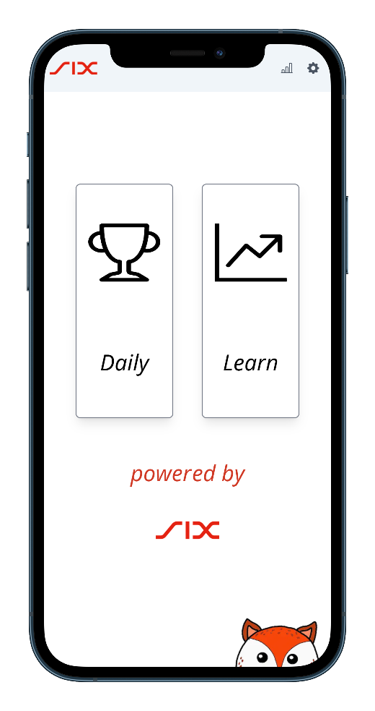
We are gamifying investing
Intuitive, mobile-first
No prior knowledge
Short interactive lessons
Instant feedback
Free to use

Slide 3
We are democratizing financial literacy

Slide 4

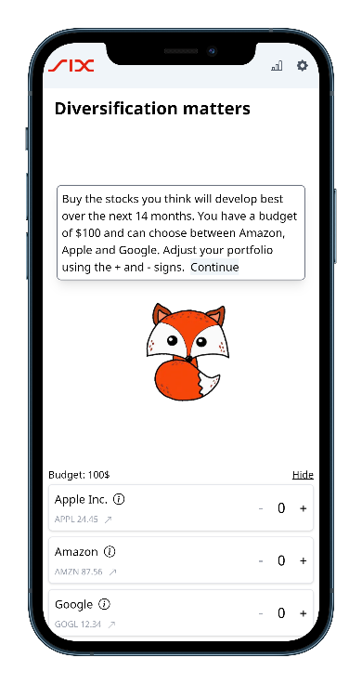
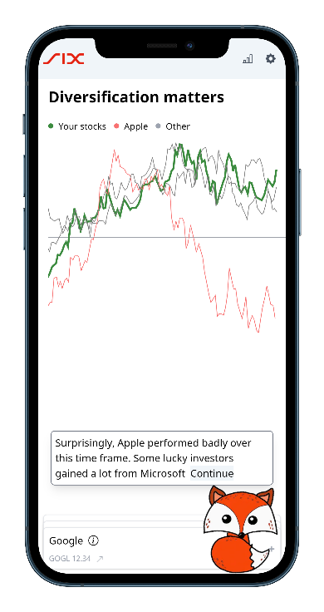
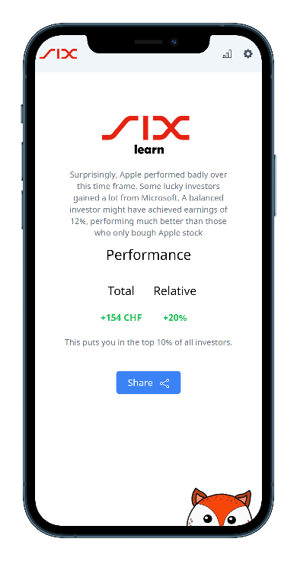
Demo

Slide 5

Driving revenue through increased participation
Inspired by Wordle & Duolinguo
Transition from game to real-world investing
Increasing stock market participation
Generating revenue through higher transaction value

Slide 6

We reach those traditionally excluded
Eliminating barriers
Broader inclusitivity
Encouraging debate
Confidence with financial concepts

